Slide 1
Homework 2
Frimu Aurel-Viorel 1231EC - IoT

Slide 2
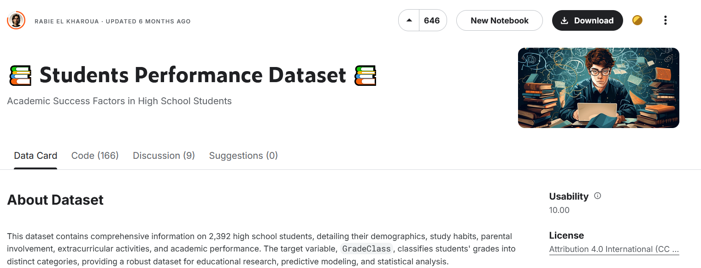
Introduction
Problem Definition: In the dataset I picked: “📚 Students Performance Dataset 📚”, the goal is to predict the GPA of students based on everything else we have about them including study time, if they’re tutored, etc

Slide 3
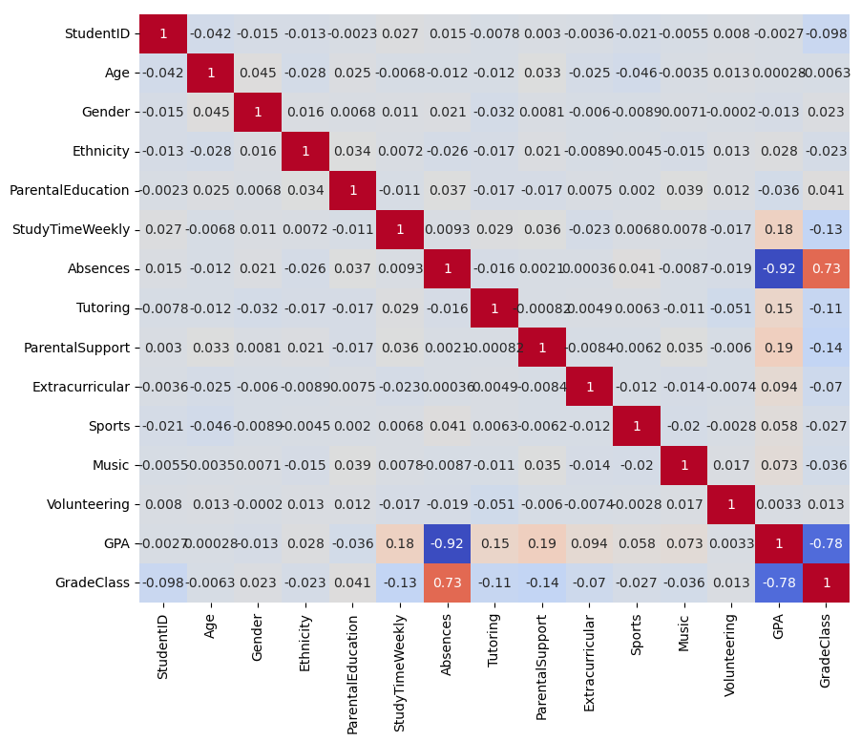
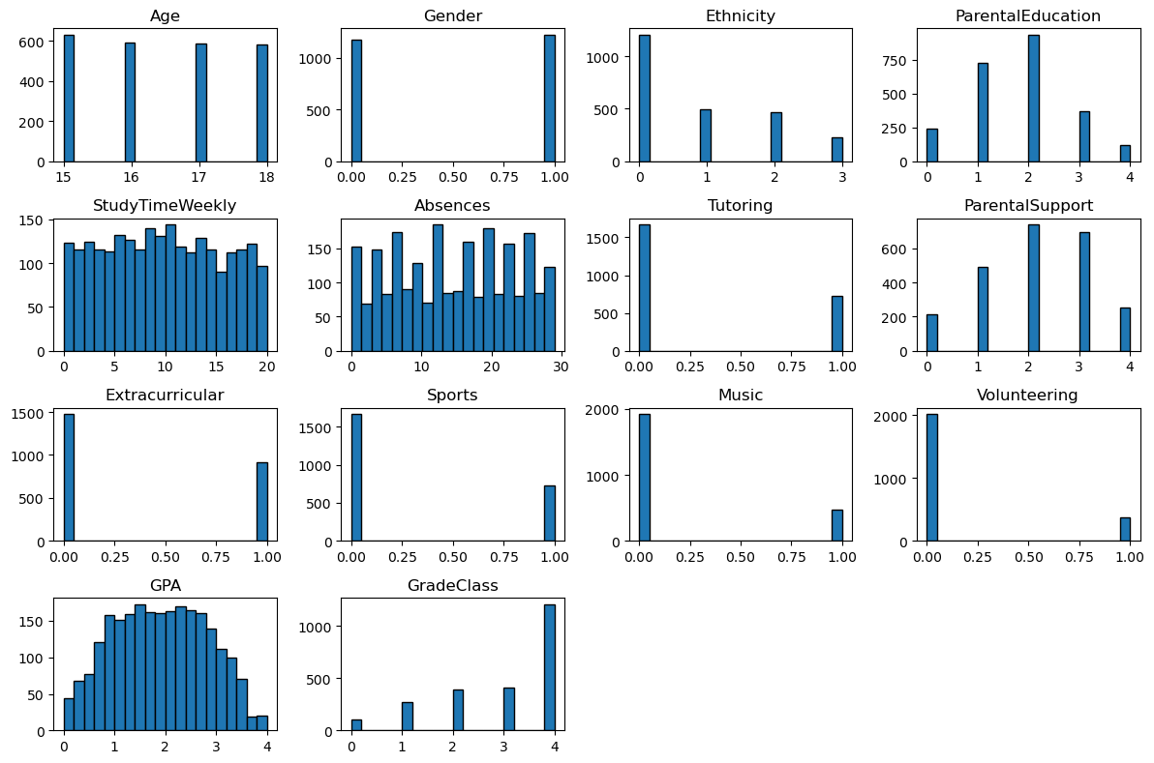
Exploratory Data Analysis (EDA)
We have both categorical and numerical variables
GradeClass is decided by the GPA.
Absences are correlated with GPA,
Implicitly also correlated with GradeClass

Slide 4
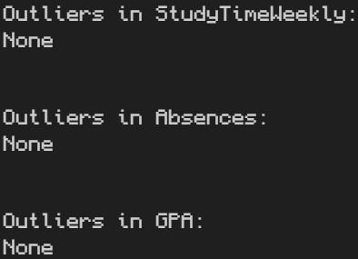

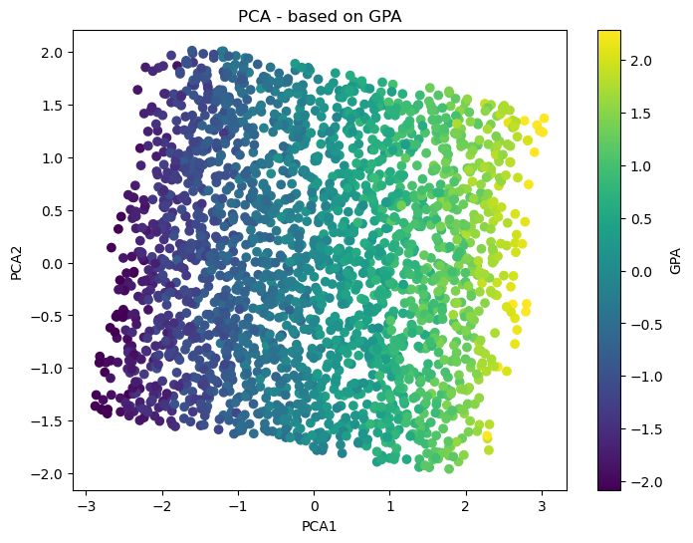
Data Preprocessing
Found no outliers in the numerical columns using IQR.
No missing values found.
Categorical data is already encoded into ints instead of text.
Standardized data -> so we can use PCA (It doesn’t like normalized)
source: https://www.datacamp.com/tutorial/normalization-vs-standardization

Slide 5
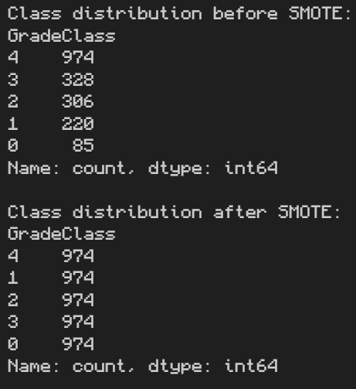
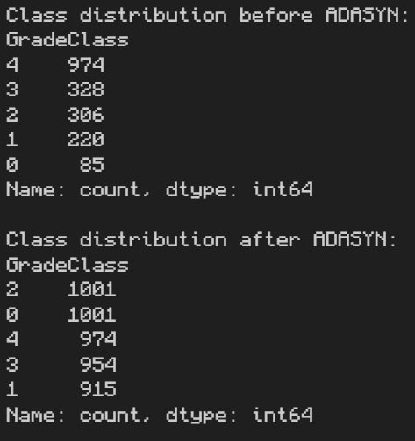
Handling Imbalance
Used both SMOTE and ADASYN for handling Imbalance.

Slide 6
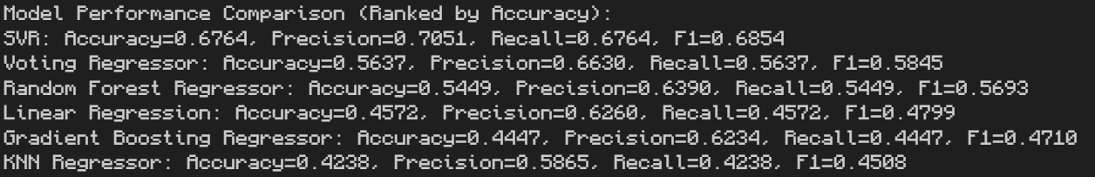
ML Models
Linear Regression: Used as a baseline model.
Random Forest Regressor: A robust ensemble method for regression tasks.
Support Vector Regressor (SVR): Suitable for high-dimensional spaces.
KNN Regressor: Simple but effective, based on neighbors.
Gradient Boosting Regressor: Boosting technique for improved performance.
Voting Regressor: Combined predictions from multiple models to boost accuracy.

Slide 7
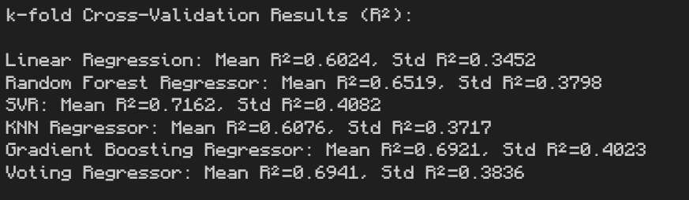
Conclusion
Based on Accuracy: SVR did the best
After Cross Validating: SVR had the best R² Mean as well as the biggest R² Standard Deviation

Slide 8

Future Improvements
Further tuning could probably enhance model performance.
Trying out other models as well can lead to a speed / accuracy boost.
Exploring the possibility of other models giving better predictions.

